Slide 1
WikiHow Automatic
Categorizer Tool
Marsha Gomez Gomez
Daria Margherita Maggi
Data Mining and Machine Learning
a.a. 2019/2020

Slide 2
Introduction

Slide 3
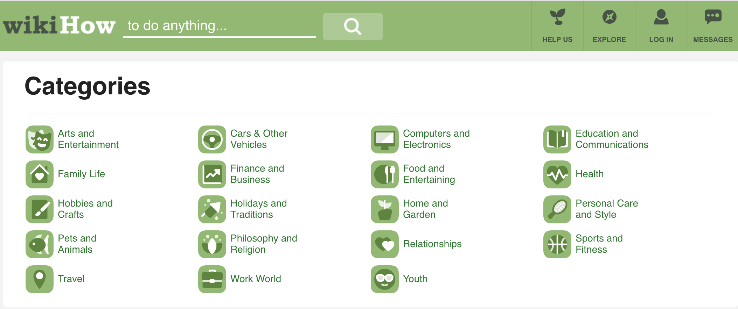
WikiHow catalogues its articles in 19 macro-categories, each one consisting of a single-root tree.

Slide 4
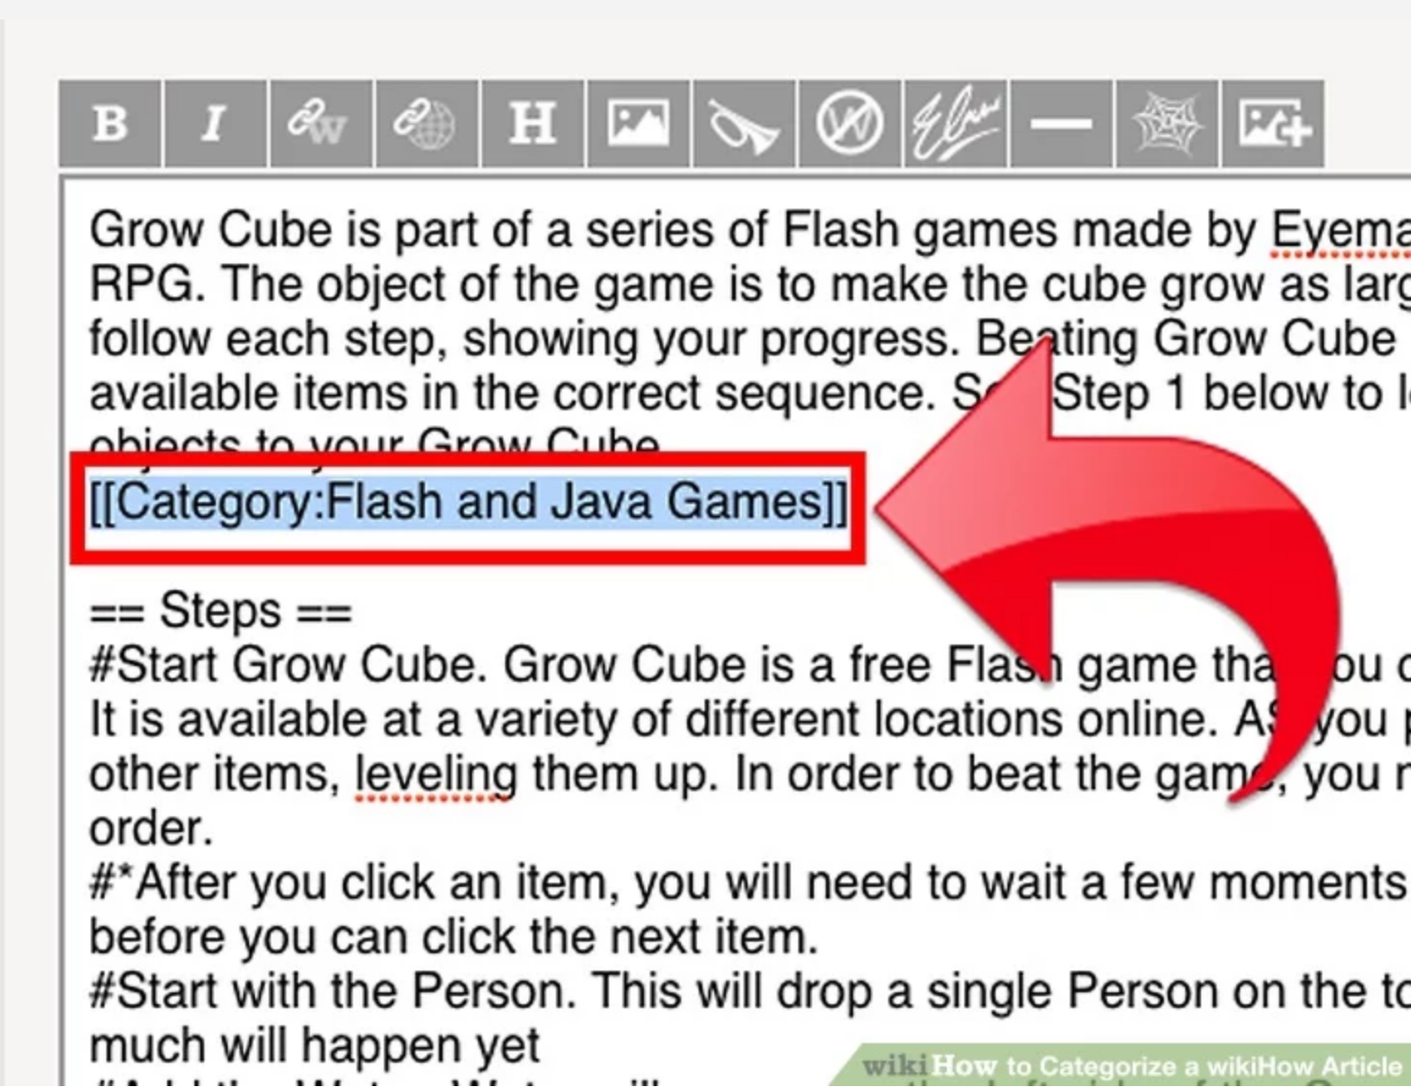
In this case, the author is labeling its article in a subcategory of Hobbies and Crafts.
WikiHow catalogues its articles in 19 macro-categories, each one consisting of a single-root tree.

Slide 5
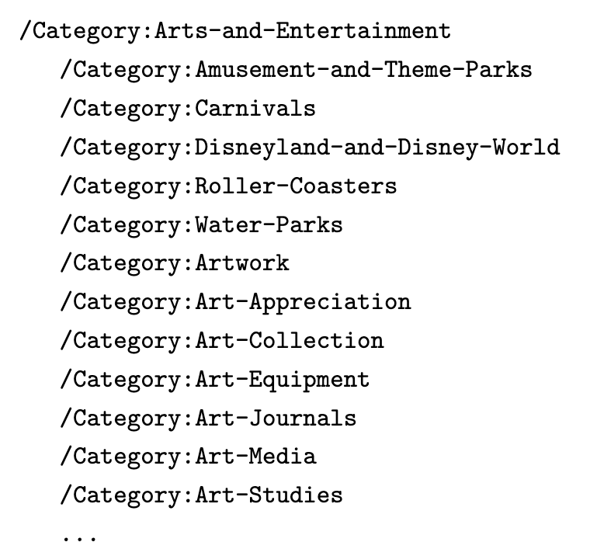
Taxonomy
Strict single-root tree structure for macro-categories.
Only one (sub-)category possible.
QA and categorization entirely manual.

Slide 6
Data Mining
Problem definition
Dataset set-up
Methods applied

Slide 7

Problem definition
Given 19 mutually exclusive possibilities, we aim to determine to which class an article should be assigned to.
In WikiHow, each article is characterized by a title beginning with the words “How to…”, a summary and a corpus divided in steps.

Slide 8
Dataset set-up
In WikiHow, each article is characterized by a title beginning with the words “How to…”, a summary and a corpus divided in steps. All of this is retrieved
Only non-empty articles written in English are considered;
All non-alphabetic characters have been identified by the means of regular expressions and removed;
Entries have been tokenized and stemmed prior to insertion.
Grammar check and cleaning.

Slide 9
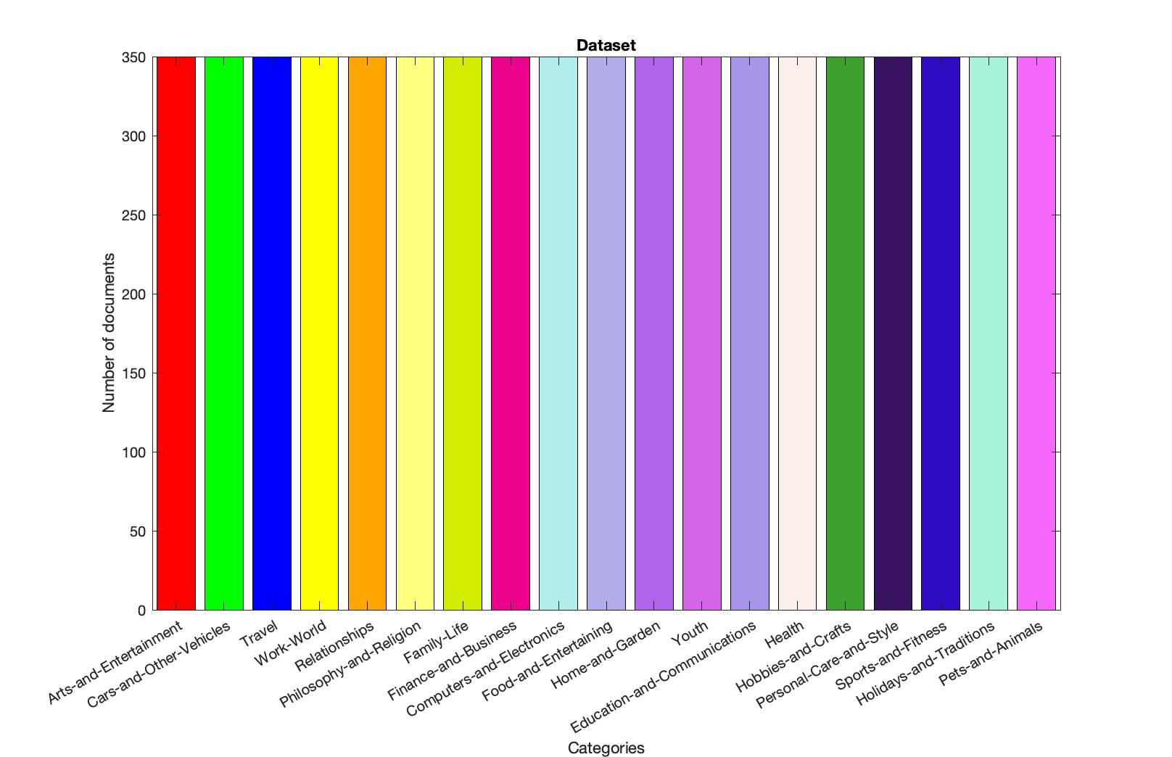
Dataset set-up

Slide 10
TITLE | SUMMARY | TEXT | CATEGORY
talent multipl area | set increas talent abil multipl disciplin audaci endeavor also feasibl accomplish fact far easier becom talent multipl area may expect practic skill wish improv upon maintain posit mindset broaden base interest knowledg help talent sort way | practic whatev tri talent know practic especi true hope talent multipl area fortun may need practic quit much think like make time practic multipl skill everi day order get time put focus hope learn practic two differ skill minut everi day month worri miss day practic one talent practic skill almost everi day month put hour focus rov [...] | Arts-and-Entertainment
Dataset set-up

Slide 11
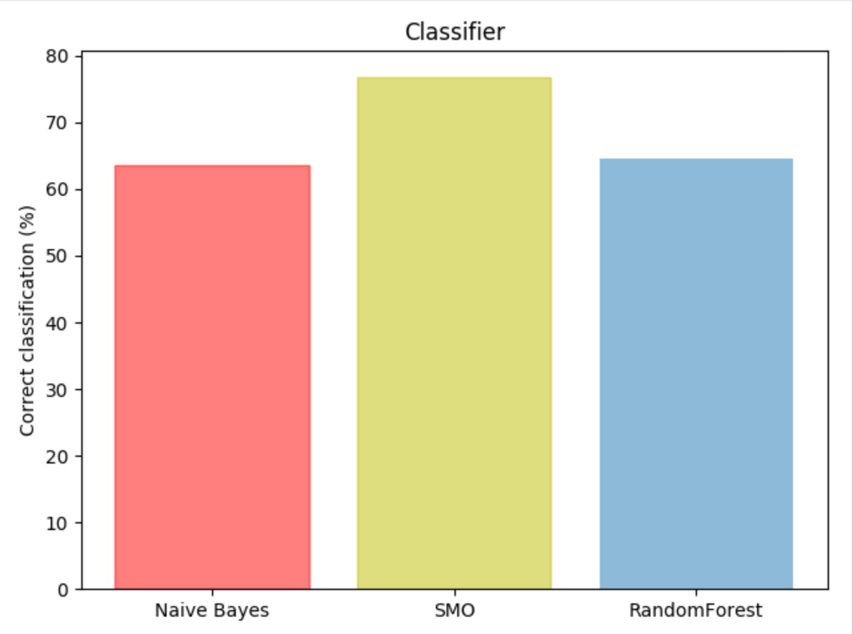
Methods applied - Classification
Random forest
SMO
Naïve Bayes
63.58%
76.85%
64.57%

Slide 12
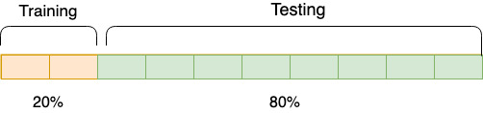
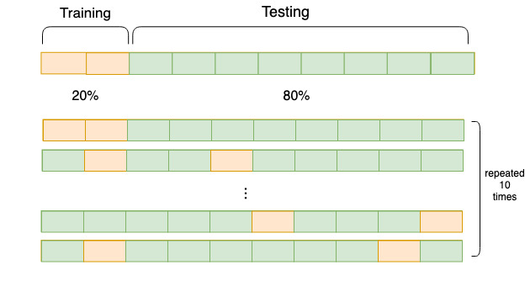
Methods applied -
10-fold
Cross validation
Testing has been carried out using 80% of the dataset as training and 20% of the dataset as test values.
Values are selected randomly.

Slide 13
Results
 | Precision | Recall | F-Measure | ROC area
Naive Bayes | 0,645 | 0,636 | 0,617 | 0,934
SMO | 0,769 | 0,769 | 0,768 | 0,963
RandomForest | 0,651 | 0,646 | 0,639 | 0,940

Slide 14
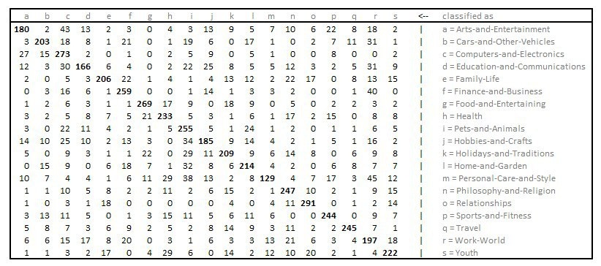
Confusion matrix - Bayes - 63.58% correctly classified

Slide 15
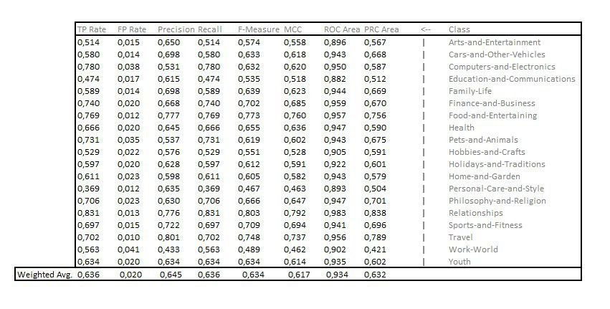
Bayes

Slide 16
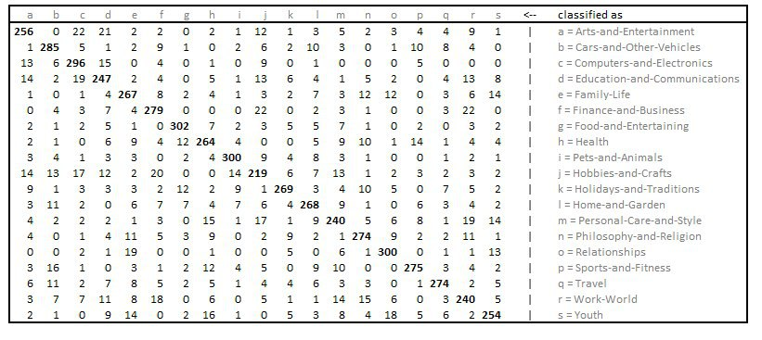
Confusion matrix - SMO -76.85% correctly classified

Slide 17
SMO

Slide 18
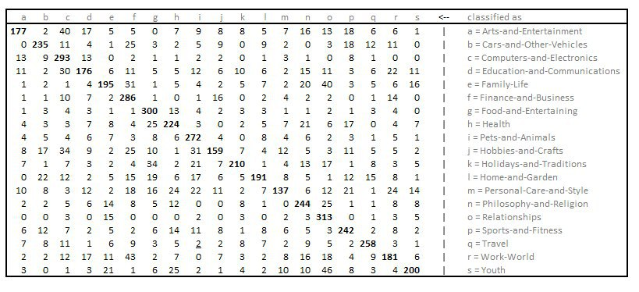
Confusion matrix - RandomForest - 64.57% correctly classified

Slide 19
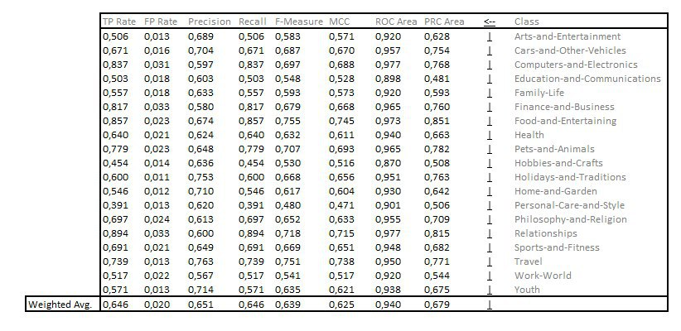
RandomForest

Slide 20
Application: Categorizer tool

Slide 21
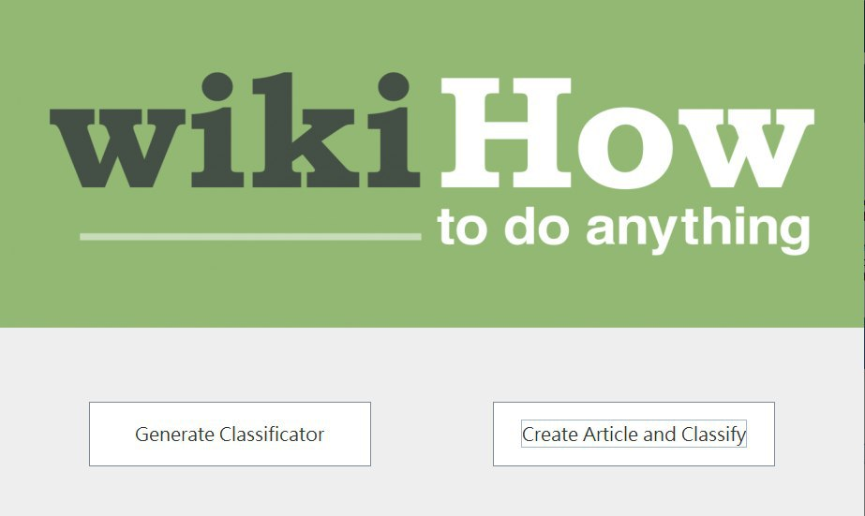
Categorizer is a mock-up for testing the models, as well as seeing the different algorithms

Slide 22
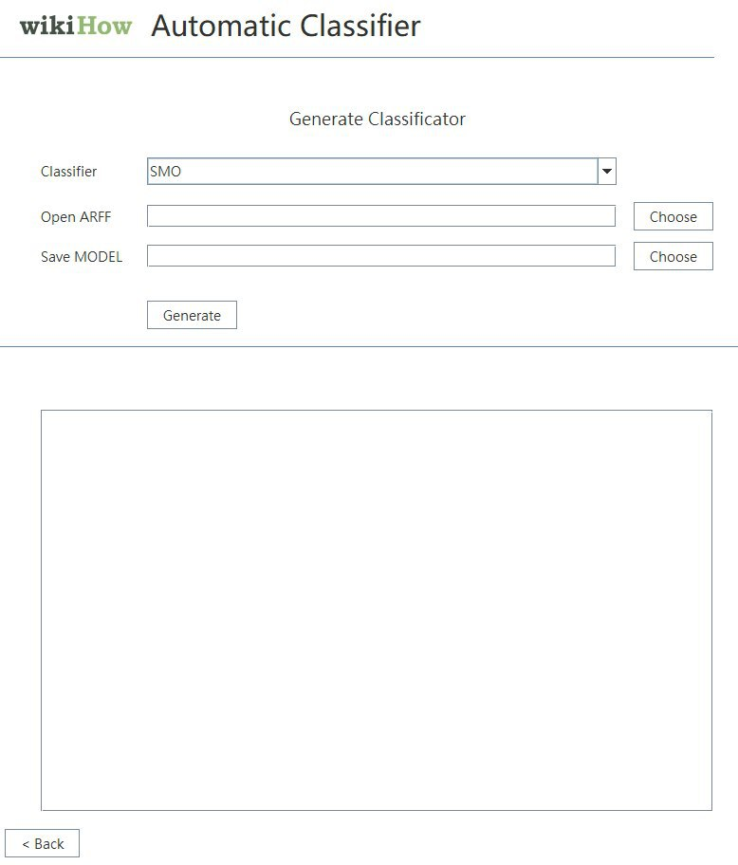
Categorizer is a mock-up for testing the models, as well as seeing the different algorithms

Slide 23
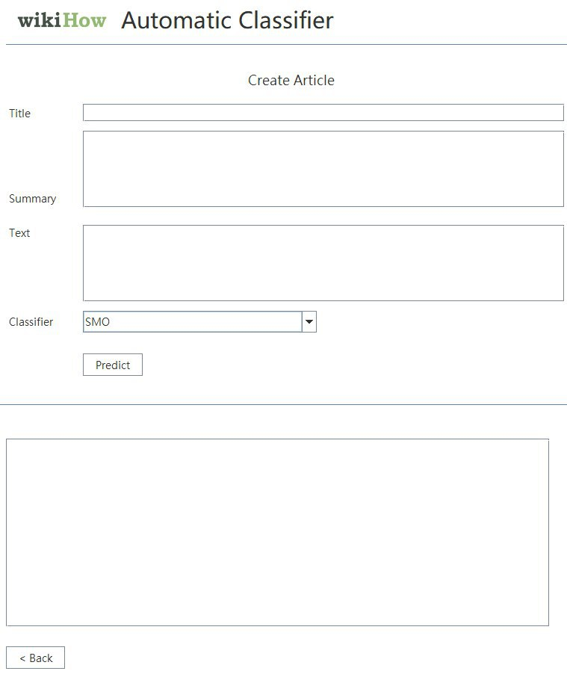
Categorizer is a mock-up for testing the models, as well as seeing the different algorithms

Slide 24
Student conclusions

Slide 25
Student conclusions
An active learner with the proposed sample selection strategies can do much better than one with only a random sampling strategy, which yields an over two-fold error reduction.
In some cases, the test set might have some problems with the data new labels which do not exist in the training set. This makes the learning problems. For example, two documents belonging to the same macro-category may actually be located in different branches of the single-root tree growing from it, and thus be different, to a point, from one another.

